Slide 1
Object Detection using OpenCV and Tensorflow API

Slide 2
Object Detection
Object detection is a computer technology related to computer vision and image processing that deals with detecting instances of semantic objects of a certain class (such as humans, buildings, or cars) in digital images and videos.

Slide 3
Requirements
Anaconda
Spyder (python IDE)
NumPy
SciPy
TensorFlow
Pillow
Keras
Matplot lib

Slide 4
Techniques used
Deep learning : SSD ( Single – Shot Multibox Detector )and YOLO(You Only Look Once) algorithms
Machine learning : Regression algorithm

Slide 5
NumPy
NumPy is the fundamental package for scientific computing with Python.
It is a library for the Python programming language, adding support for large, multi-dimensional arrays and matrices, along with a large collection of high-level mathematical functions to operate on these arrays.

Slide 6
SciPy :
SciPy is a library that uses NumPy for more mathematical functions.
SciPy uses NumPy arrays as the basic data structure, and comes with modules for various commonly used tasks in scientific programming.
It includes linear algebra, integration (calculus), ordinary differential equation solving and signal processing.

Slide 7
TensorFlow :
TensorFlow is an open source software library released in 2015 by Google to make it easier for developers to design, build, and train deep learning models.
It is a symbolic math library, and is also used for machine learning applications such as neural networks.

Slide 8
Pillow :
Python Image Library (abbreviated as PIL) (in newer versions known as Pillow) is a free library for the Python programming language that adds support for opening, manipulating, and saving many different image file formats.
per-pixel manipulations,
masking and transparency handling,
image filtering, such as blurring, contouring, smoothing, or edge finding,
image enhancing, such as sharpening, adjusting brightness, contrast or color,
adding text to images and much more.

Slide 9
Description
One of the important fields of Artificial Intelligence is Computer Vision.
Computer Vision is the science of computers and software systems that can recognize and understand images and scenes.
Computer Vision is also composed of various aspects such as image recognition, object detection, image generation, image super-resolution and more.

Slide 10
Object detection refers to the capability of computer and software systems to locate objects in an image/scene and identify each object.
Object detection has been widely used for face detection, vehicle detection, pedestrian counting, web images, security systems and driverless cars

Slide 11
Here we have used the R-CNN stands for Regional – Convolutional Neural Networks.
R-CNN is familiar with tensorflow , where object represents a partially defined computation that will eventually produce a value.

Slide 12
Image AI
ImageAI provides many more features useful for customization and production capable deployments for object detection tasks.
Invented by john Olewefans and Moses Olewefans.

Slide 13
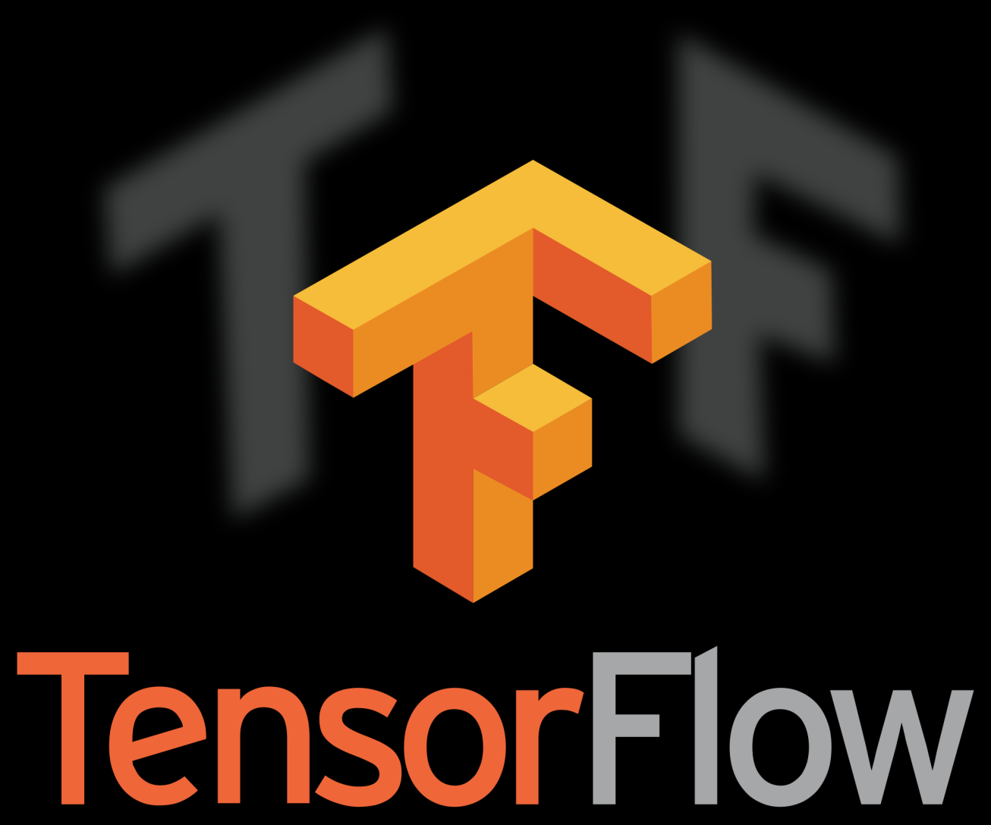
Tensorflow API

Slide 14


Proposed system

Slide 15
Data set
It is defined as , a collection of related sets of information that is composed of separate elements but can be manipulated as a unit by a computer.
In this project the trained dataset we used is Retina Set.

Slide 16
Advantages of ImageAI
Predicting Probability
Fast in detecting the object in an image
Easily we can parse the input and we can get the output of any respective image.

Slide 17
program
from imageai.Detection import ObjectDetection
import os
execution_path = os.getcwd()
detector = ObjectDetection()
detector.setModelTypeAsRetinaNet()
detector.setModelPath( os.path.join(execution_path , "resnet50_coco_best_v2.0.1.h5"))
detector.loadModel()
detections = detector.detectObjectsFromImage(input_image=os.path.join(execution_path , "image.jpg"), output_image_path=os.path.join(execution_path , "imagenew.jpg"))
for eachObject in detections:
print(eachObject["name"] , " : " , eachObject["percentage_probability"] )

Slide 18
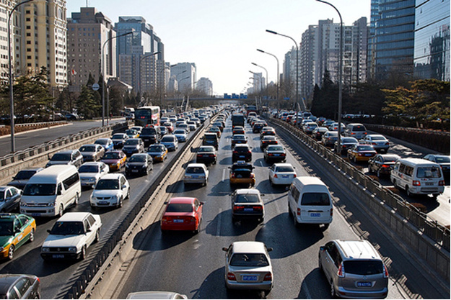
Sample input

Slide 19
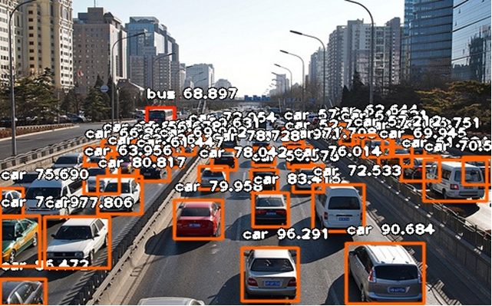
output

Slide 20
Future enhancement
Our main vision is to integrate this software part with hardware part i.e., raspberry pi.
With the help of pi cam , we connect it to raspberry board with the help of a ribbon cable.

Slide 21
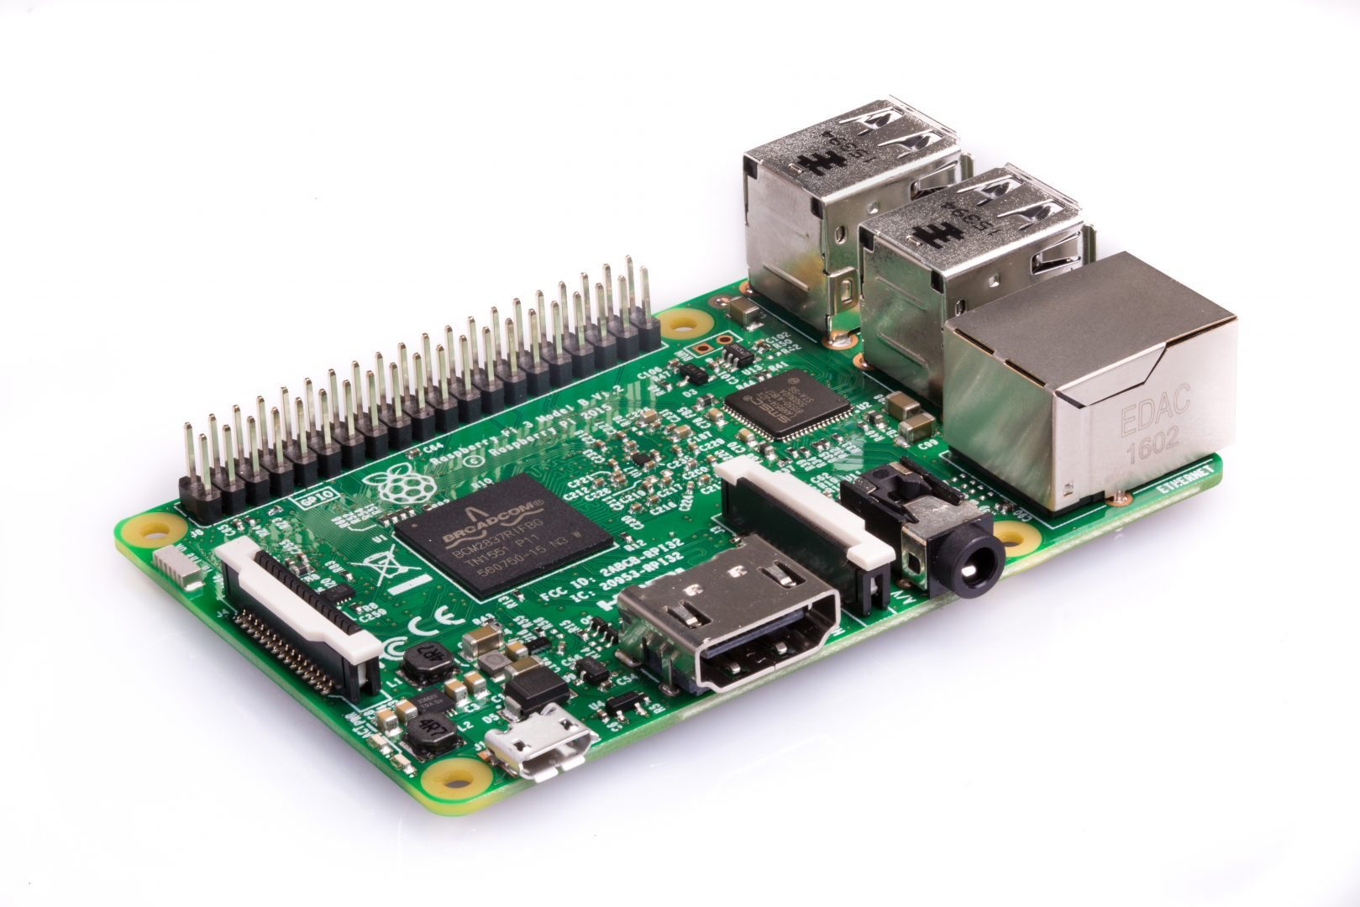
Raspberry pi

Slide 22
Pi cam
Pi cam attaches to raspberry Pi by way of one of the small sockets on the board upper surface and uses the dedicated CSi interface, designed especially for interfacing to cameras.

Slide 23
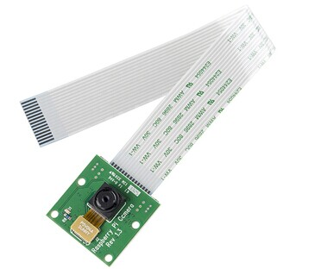
Pi cam

Slide 24
Execution
If you execute with the help of pi, then the following output will be displayed.

Slide 25
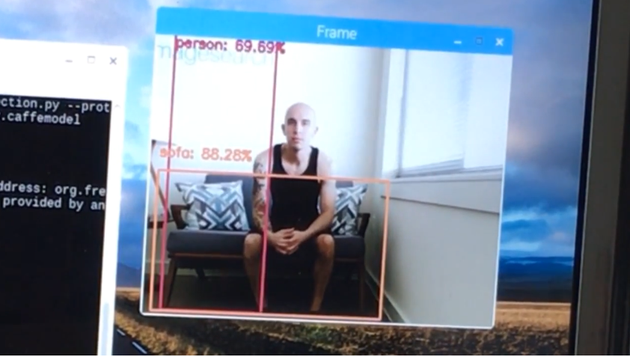

Slide 26
Applications
Face detection
Self driving cars
Pedestrian counting
Web images
Security systems

Slide 27
Reference
https://www.expertsystem.com/machine-learning-definition/
https://www.kdnuggets.com/2017/10/top-10-machine-learning-algorithms-beginners.html

Slide 28


